Slide 1

Software Engineering 2015
Notes:
Mason starts the intro etc

Slide 2
Overview
Project Description
What went right
What went wrong
What we hoped the end product would be
What the End Product actually is
Live Demonstration
How it works
1
Notes:
Mason
This is what we will be talking about in this presentation etc
Quick run down of each topic,

Slide 3
What is SwimSafe?
Interactive map
Informs users about safe swimming
Displays approximate water quality information
2
Notes:
Mason
Talk about what swimsafe is and what it does
Swimsafe is about preventing accidents while swimming, it can be used by a parent or a someone unfamiliar with the area to easy see safety information about a particular swimming area

Slide 4
What went right
Google maps API
PHP
JavaScript
Database, server setup
3
Notes:
Sam / Andrew
Google maps API is great and easy to work with for the most part
We have no web background. We learned some PHP during the development cycle of this app
We learned Javascript and used it to interface with the Google maps API. It’s used to create markers and infowindows etc
Our original database design was on point. We got setup with apache etc early which provided a good platform to test our project on multiple devices etc

Slide 5
What went wrong
InfoWindow styling
Acquiring live data
4
Notes:
Andrew
Infowindow styling is difficult, it requires implementing Jquery, resources online didn’t seem to work in our case. We suspect that the latest version of the google maps API or Jquery has made this more difficult that it used to be.
Aquiring live data was problematic. Andrew says what happened with communications etc

Slide 6
What we hoped the Product would be
Easy to use
Intuitive
Live data about swimming locations
5
Notes:
Mason
The app was meant to be intuitive, quick, easy and it should was to display live water quality / safety information. We achieved this for the most part except for the live data.
The structure is there for live data and we could basically point the app at a different server or periodically update our local server in order to make the system start working with lived data.
The current system is scalable, so adding more data about more swimming spots will be handled automatically.

Slide 7
The End Product
Live Demo
6
Notes:
Someone click around talk about colours / disclaimer / design. Mention we made the site as simple as possible from a user perspective because it is meant to be used on the go. People don’t want to use an app that bombards them with
Information or w/e

Slide 8
How it works
MySQL
PHP
JavaScript
HTML
7
Notes:
Andrew
The system uses MySQL as a backend database, the system is hosted on a webserver etc

Slide 9
How it works
MySQL
Latitude / longitude
Quality levels
Danger levels
8
Notes:
Andrew
(database design choice stuff goes here)

Slide 10
How it works
PHP
Retrieves information from the database
Creates an array for each column in the database
JSON encoding
9
Notes:
Sam
PHP script queries the database and creates an array from each column in the database
This leads to each point in the array being about the same swimming location e.g. the first row of data is held in index [0] in each of the array’s
JSON encoding allows the arrays that PHP made to be readable by the javascript

Slide 11
How it works
JavaScript
Google Maps API
GeoLocation
Marker / InfoWindow creation
Content string
10
Notes:
Sam
google maps API is great for the most part.
We used

Slide 12
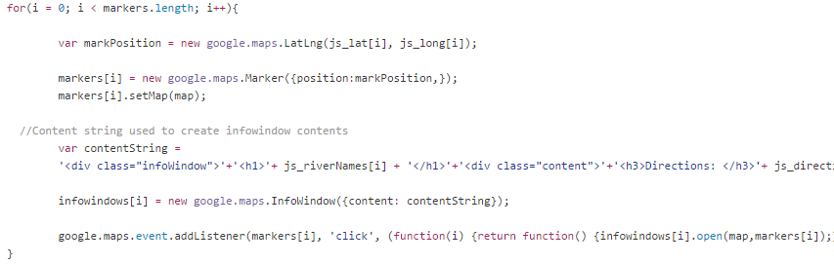
Google Maps API
Maps / Markers and InfoWindows are objects
11
Notes:
Sam

Slide 13
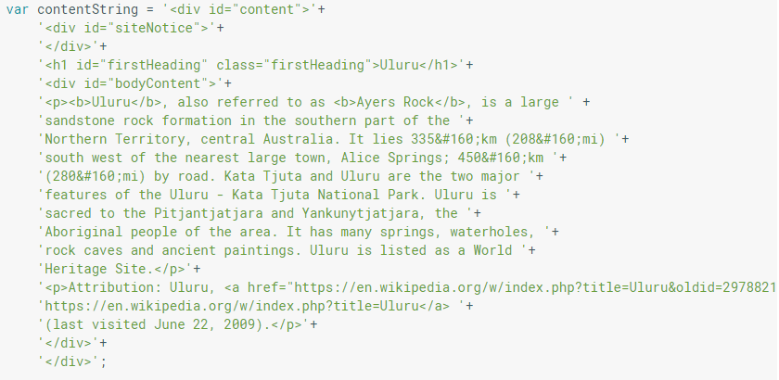
Google Maps API
Content string is a string of HTML that will be inserted into the infowindow
12
Notes:
Sam

Slide 14
Questions?

